Slide 1
Friends Overview
april 8, 2025
friends annual meeting

Slide 2
Agenda
Welcome
Friends Update
Financial Update
Book Sale Financial Update
Holiday Basket Auction
Membership
Q&A

Slide 3
Friends Board & Meetings
Meetings – monthly, 2nd Tuesday of the month except July and December
Location – Staff conference room or meeting room
6:30 – 8:30 pm
Public welcome
President – Don Walker
Vice President – Michelle Jerome
Secretary – Colleen Vieira
Treasurer – Julie Melchert
Fundraising Chair – Barb Shea Pote
Book Sale Chair – Janet Lane
Membership Chair – Amanda Kalinsky
Publicity Chair – Monica Doneth
Did you know?
Board members serve 2-year terms and are elected in odd years.
The next election after tonight is April 2027

Slide 4
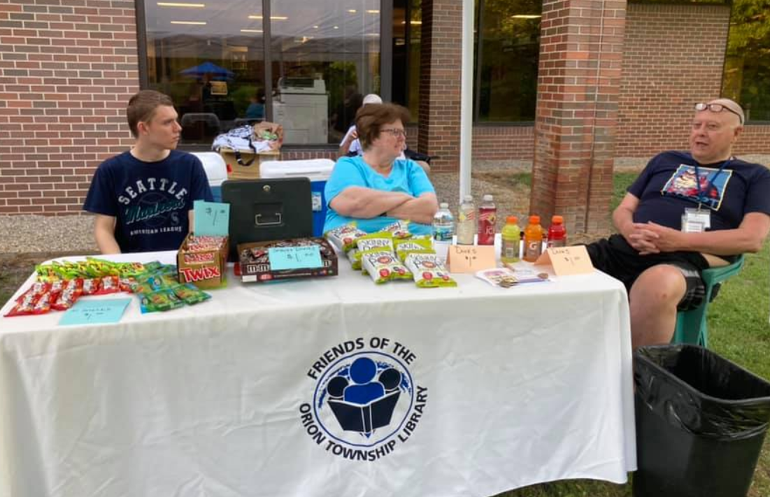
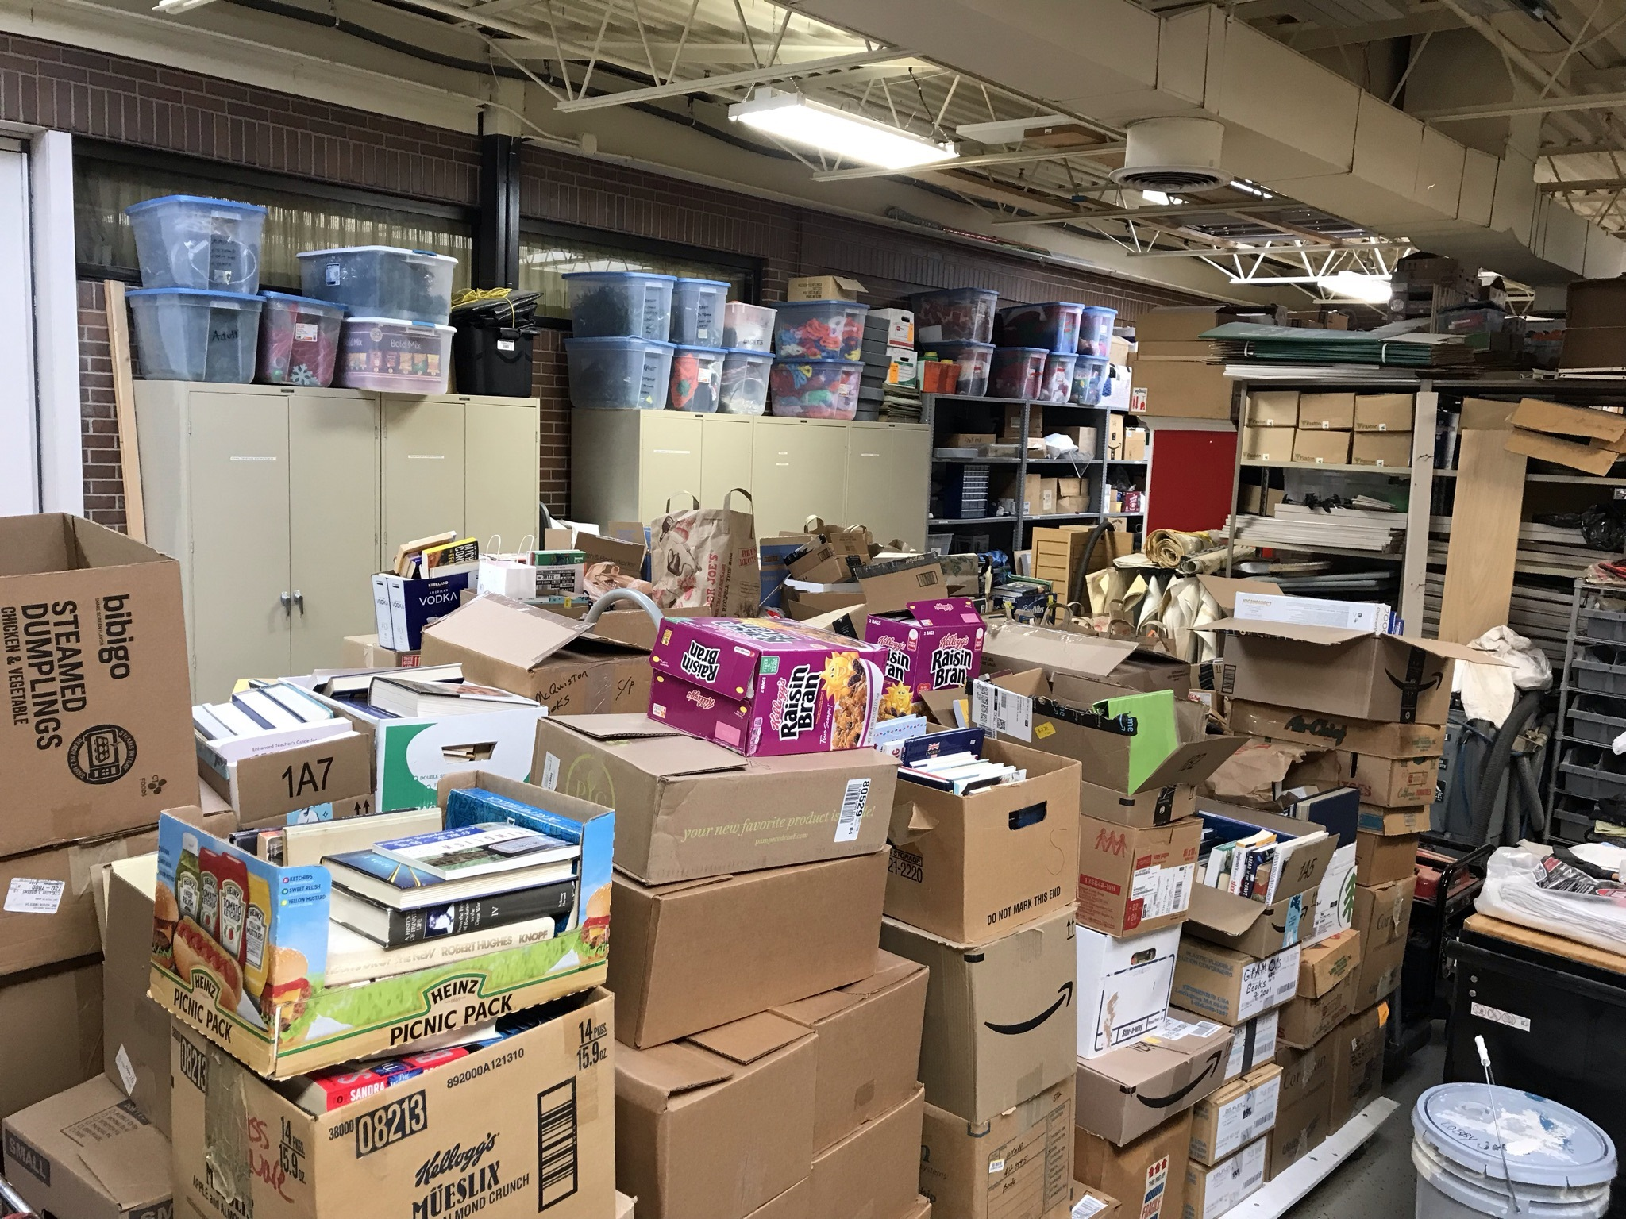
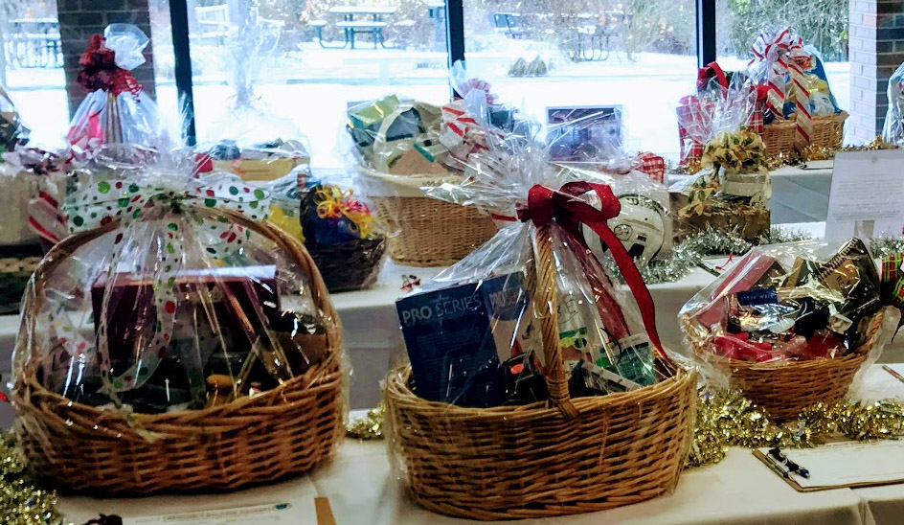
CALENDAR OF ACTIVITIES FY 2024-25
OUTREACH
FUNDRAISING
Facebook
Summer Reading
Battle of the Books
Orion Living magazine 4x/yr
Natl Library Week (Apr) & Natl Friends of Library Week (Oct)
Annual Meeting (Apr)
Book Store
Fall Book Sale
Holiday Auction
Winter Book Sale
Spring Book Sale (May 14-19)
Tote bags
Kroger Rewards

Slide 5
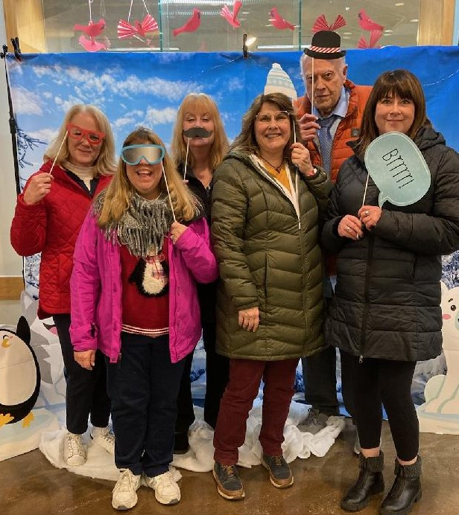
We Support Library Programming
The Friends have donated over $350,000 for programming since 2011
2021 - $20,000
2022 - $40,000
2023 - $25,000
2024 - $25,000
Plus over $80,640 additional donations for renovations and gifts since 2017
Adult, Teen, Youth & Outreach Services Programming
Battle of the Books
Summer Reading Program
Author Visits, Speakers & Performers
National Library Week celebration

Slide 6
Friends Snapshot (FY 2024-25)
Financials (as of 3/31/25) | Fundraising Overview
Income: $44,118 Book Sales 70% Donations 11% Holiday Baskets 15% Memberships 1% Investment Income $2,097 Other 3% Expense: $3,253 Gifts to Library: $25,000 – Grant $17,840 - Sign Balance Sheet: $92,854 | Used Book Sales: January, May & September Pre-Covid $4,000 per sale Post-Covid $5,500 per sale Twice Told Tales: Daily sales in library lobby Average $6,000 per quarter in sales Holiday Basket Auction: $6,420 in 2024 Donations Kroger Rewards Patrons Tote bag sales

Slide 7
TWICE TOLD TALES BOOK STORE SALES | 2018-2024
*Library closed for fire damage in 2024

Slide 8
3X-YR USED book sales | 2018-2024
Includes dollars raised through 3x-year gently used book sales, hosted in January, May & September
2020 winter only
2021 fall only
2022 spring & fall only
Missed May 2024 sale due to fire & includes summer pop-up sales

Slide 9
BOOK SALES BY YEAR 2018-2024
Includes dollars raised through 3x-year gently used book sales and Twice Told Tales bookstore

Slide 10
2024 Holiday BASKET auction
Since 2014, the Friends have raised over $54,000 selling baskets
2024 – 54 baskets
Net proceeds $6,420

Slide 11
HOLIDAY AUCTION BY YEAR | 2018-2024

Slide 12
Financial NOTES
As of July 2021, Square cash register processes credit cards at book sales and provides detailed reporting of items sold
As of Sep 2021, Square is used for online membership purchases & donations (previously PayPal)
Partnerships:
Kroger Rewards –$5,734 received since 2017
Board approved cash reserve is $40,000
MI 6% sales tax paid on all books sold

Slide 13
MEMBERSHIP
Membership sales are 1% of our yearly income
Family, individual, and senior memberships available ($20, $10, $5)
139 current memberships
48 life memberships
Renewal notices are being sent to members asking for support in the FY24-25 year. Renewals can be done online, by mail, at book sales, or at the library service desk.
Members gain early access to book sales held in January, May & September
Special membership event is currently being planned to learn about Makerspace equipment and More Than Tools collection

Slide 14
FY23-24 Highlights + FY24-25 Goals
FY23-24 Highlights
Grants to OTPL for $25,000 – programming & more than books collection
Donation of $17,840 for half of the cost of new monument sign on Joslyn Road
Welcomed new board members Monica and Amanda
Book sale profits affected by the fire at OTPL
Partnership with Thrift Books and Better World Books to sell and donate unsold books
Extended used book sale hours to teachers only
New Friends webpage – friendsorionlibrary.org
Friends merchandise – available for purchase on our website
FY24-25 Goals
Increase volunteer participation in book sales and board work
New fundraising ideas
Extend used book sale hours to teachers only for the September 2025 sale
Additional special purpose funds to OTPL
Host membership and donor events

Slide 15
Q & A
Thank you!

